Slide 1
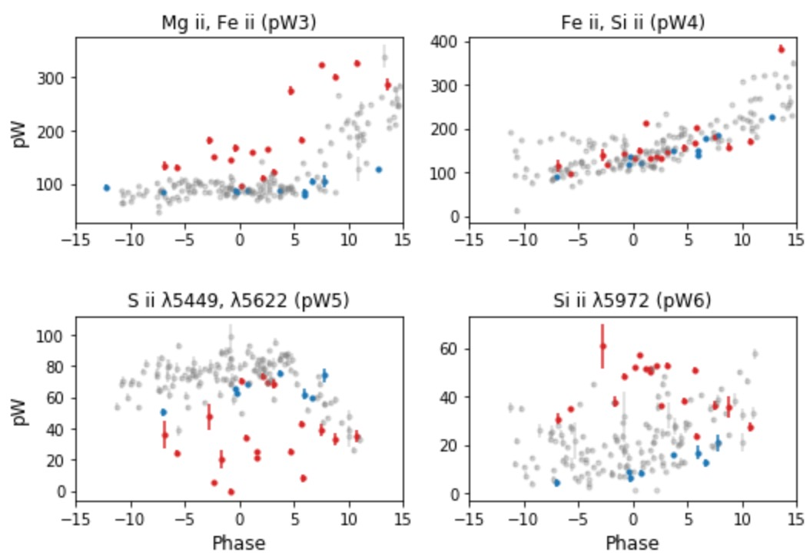
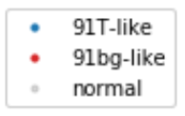
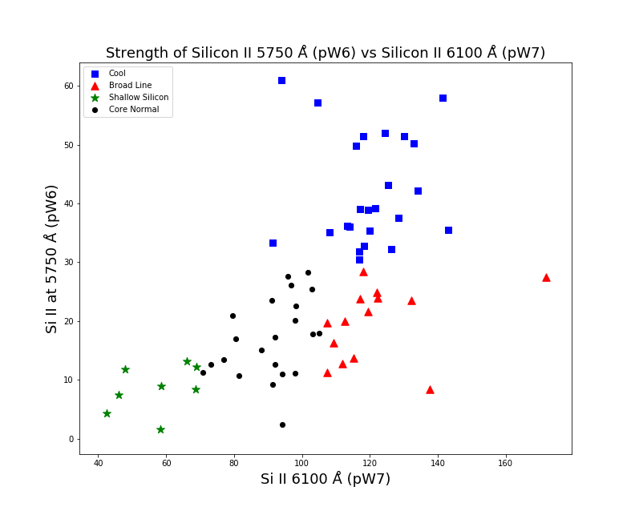
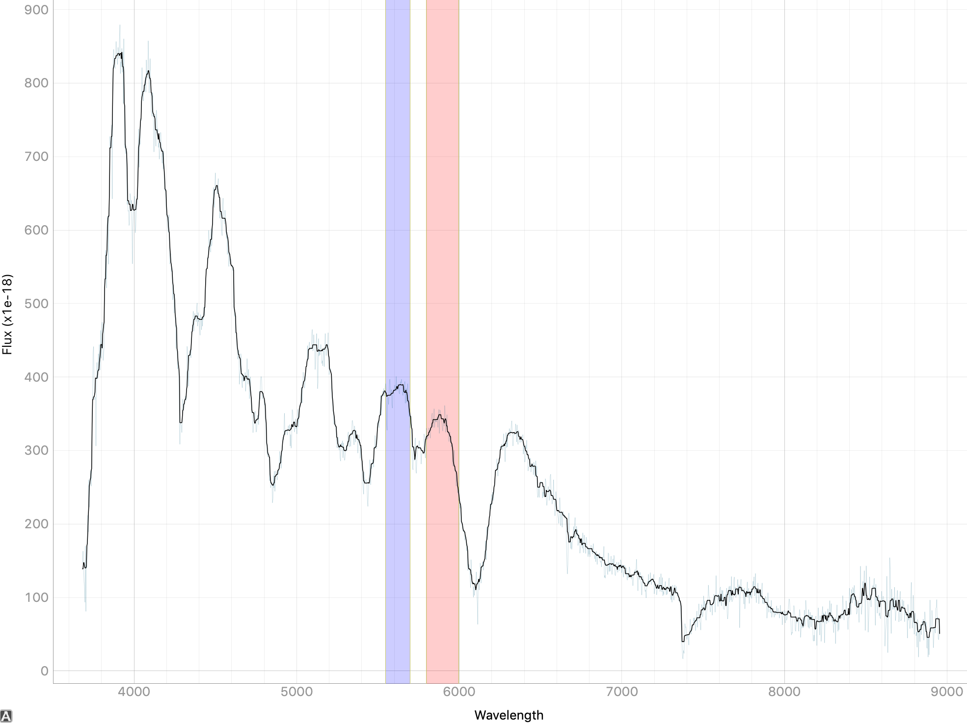


Classification of Type Ia Supernovae Based on Comparison of Silicon II Absorption Features
Emily Forsyth and Ella Kane
University of Pittsburgh, Department of Physics and Astronomy
Introduction
Methodology
Results
Type Ia supernovae (SNe Ia) make up a branch of remarkably homogeneous objects, due to the nature of their formation. When a white dwarf accumulates mass up to 1.4 solar masses, known as the Chandrasekhar Limit, it can no longer resist the force of gravity and collapses. Because all stars “go nova” at this mass, SNe Ia have roughly the same absolute magnitude (after corrections). Objects that have homogeneous qualities and known brightness's can be used as standard candles to judge distance based on their comparative observed brightness's. Standard candles are extremely important in improving our understanding of the expansion of the universe.
Unfortunately, SNe Ia are not perfect standard candles, and still carry some intrinsic differences that hinder their effectiveness. By classifying SNe Ia into subtypes by some parameter, we can correct their differences to use SNe Ia as standard candles.
One way SNe Ia are classified is based on the comparison between silicon absorption features in the spectra. Supernovae spectra display characteristic dips at specific wavelengths where different elements are absorbed. The two silicon features investigated during this classification process are Silicon II at 5750 Angstroms (represented by pW6) and at 6100 Angstroms (pW7).
The spectra analyzed below are obtained from The Carnegie Supernova Project (CSP), data release one (DR1), containing 93 SNe Ia.
Using the feature analyzer described in Fig. 1, the pseudo-equivalent width is measured for each feature (pW1-pW8). The Pseudo-equivalent width is a straight line between the peaks in the flux on either side of the absorption feature. It is an indication of the strength of the feature. This is done manually to prevent machine error in estimating the flux peaks to be at the highest point within the boundaries. This is not always the case, as noise and the phase of the supernovae can affect where the program detects “peak flux”.
The strength of the two silicon II features are then plotted against each other and classified based on their depth, width, and shape. The Branch 2006 classification techniques are used to create Fig. 2. which shows the four ”Branch subtypes”.
These are Core Normal SNe Ia (highly homogeneous with similar pW7 features and similar relationships between Si II features), Broad Line SNe Ia (spectroscopically normal with characteristically broader and deeper pW7 features), Cool SNe Ia (large pW6 features and a distinct absorption dip from 4000 to 4400 Å due to Ti II), and Shallow Silicon SNe Ia (shallow pW6 and pW7 features).
.
Fig. 2 addresses the question posed in Branch ‘06 as to whether SNe Ia fall into distinct subtypes, or if they follow a continuous distribution. Branch ‘06 concludes the latter, and Fig. 2 agrees with this conclusion.
Our results suggest that most SNe Ia may be variations of normal SNe Ia, where heterogeneity reflects differences in degree rather than type. Thus, the boundaries between subtypes are trivial.
Figure 3. This figure shows pW strength vs. phase. It demonstrates that for some ions (like the top two plots), feature strength has a time dependency and in others (like the bottom two) strength appears independent of phase. Note the differences between classifications.
Conclusion
The comparison of these two important Silicon II features and the subtyping of SNe Ia are important when returning to thinking about SNe Ia as standard candles. Because standard candles demand a high level of homogeneity, if the reasons behind the differences in SNe Ia are better understood, the SNe Ia can be corrected for these differences. This would improve their usefulness and accuracy as standard candles.
This project is ongoing and we are working on extending our analysis to the Sloan Digital Sky Survey (SDSS). With a larger data set we will hopefully be able to more definitively confirm the trends we saw in CSP. We hope to perform additional analysis of feature strength with respect to redshift, ejection velocity, host galaxy properties and other parameters.
One limitation of this experiment is the size of our data set. Because we needed to manually detect the beginning and end of features, there was a bias toward spectra with little noise and clean features. This gives a smaller data set overall and may limit the amount of unusual SNe analyzed.
Flux
Wavelength (Å)
Figure 1. An example of a spectrum of a type Ia supernova (object ID 2004ef). Flux is plotted against wavelength (Å). This image is from the feature analyzer used to measure the pWs of features. The wavelength boundaries for Si II (pW6) are highlighted. To the right of pW6 is the characteristic dip of pW7 just beyond 6000 Å.
Figure 2. A scatterplot comparison of the strengths of two Si II features, pW6 and pW7. The respective SNe Ia are then classified into the four “Branch subtypes”, according to the legend.

